Slide 1
Impact Assessments for
Xylella fastidiosa subsp. pauca in Europe
Kevin Schneider
kevin.schneider@wur.nl
Wageningen University and Research
EFSA PLH Session on Impact Assessment Methodologies, 25th of March 2021

Slide 2
Acknowledgements
Funding
EU H2020 Pest Organisms Threatening Europe (POnTE) #635646.
Anunna High Performance Computing Cluster of Wageningen University
People
Wopke van der Werf (WUR)
Monique Mourits (WUR)
Alfons Oude Lansink (WUR)
Juan A. Navas-Cortes (CSIC)
Martina Cendoya (IVIA)
Antonio Vicent (IVIA)
Lia Hemerik (WUR)
Donato Boscia (IPSP)
Articles
Schneider, K., Van der Werf, W., Cendoya, M., Mourits, M., Navas-Cortés, J. A., Vicent, A., & Oude Lansink, A. (2020). Impact of Xylella fastidiosa subspecies pauca in European olives. Proceedings of the National Academy of Sciences, 117(17), 9250-9259.
https://doi.org/10.1073/pnas.1912206117
Schneider, K., Mourits, M., Van der Werf, W., & Oude Lansink, A. (2021). On Consumer Impact from Xylella fastidiosa subspecies pauca. Ecological Economics (in press)

Slide 3
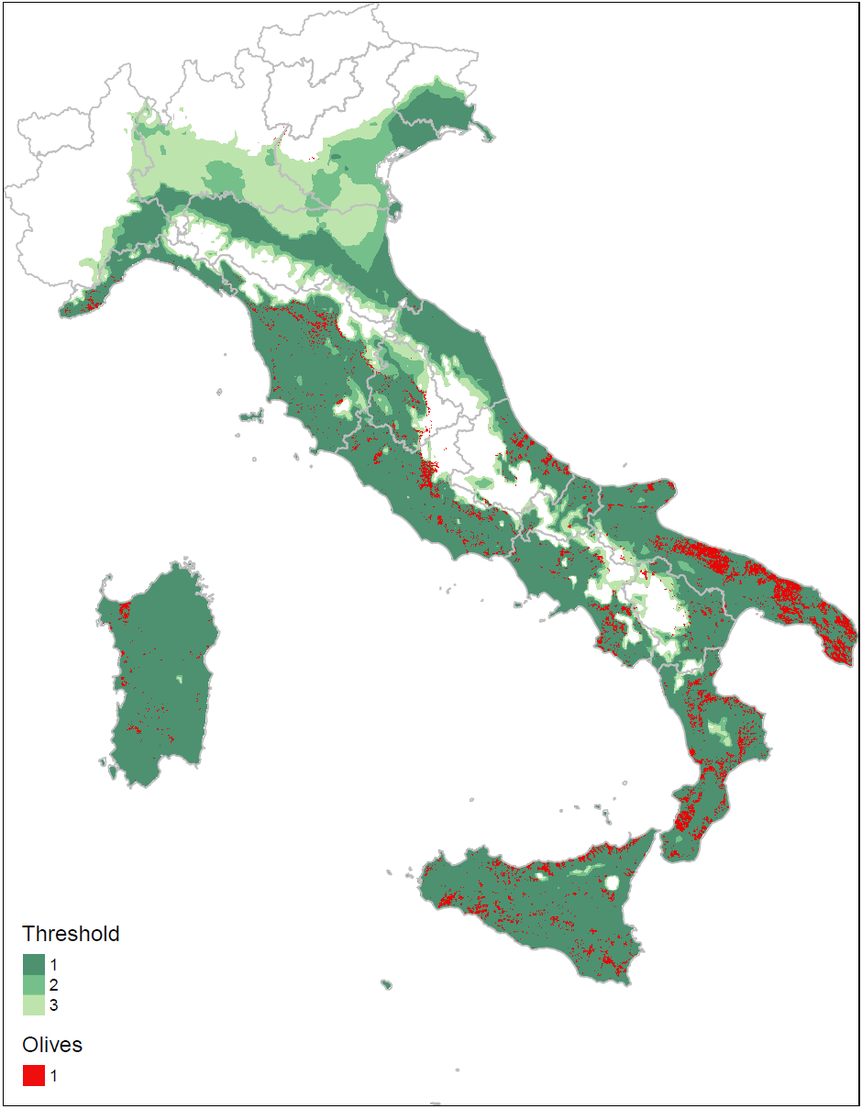
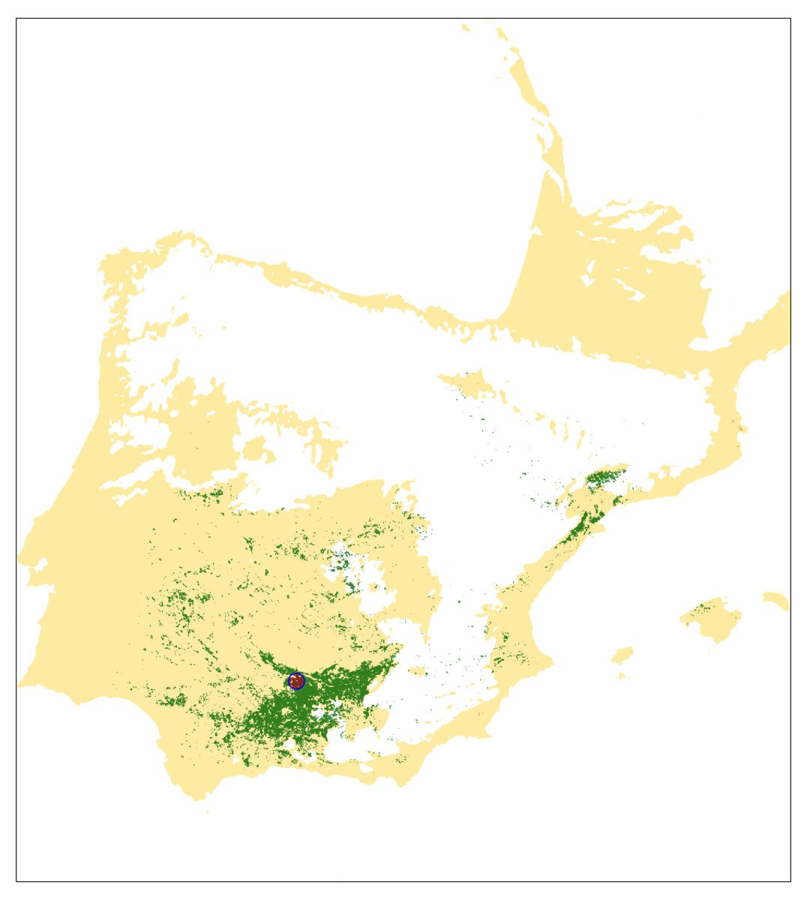
From spread to impact
Binary prediction of climatic suitability
Land cover data on expected olive locations
Radial range expansion over discrete time steps
Cellular automaton with alternating step types
Spread through suitable habitat only
From number of infected cells compute percent of cells invaded

Slide 4
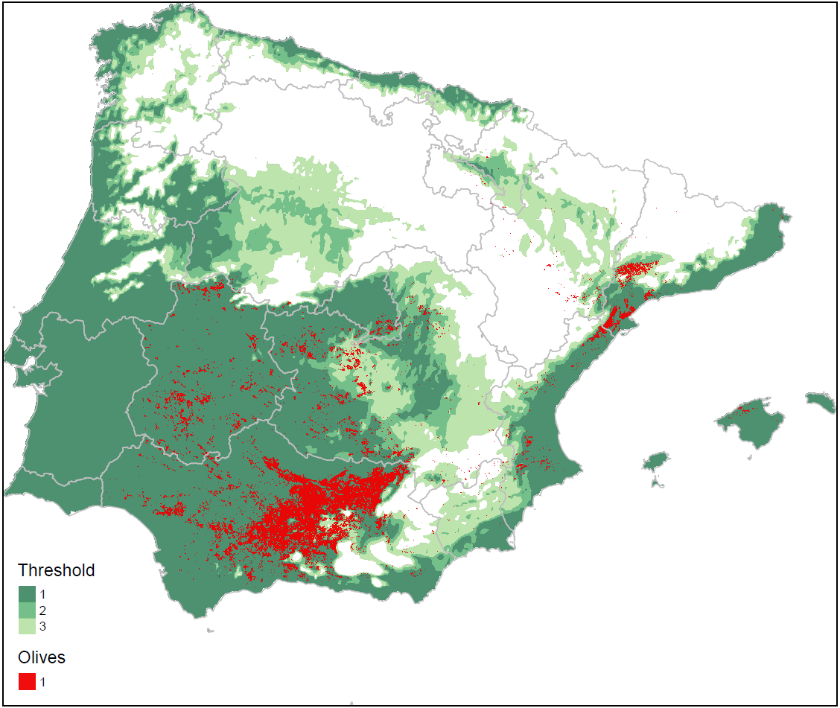
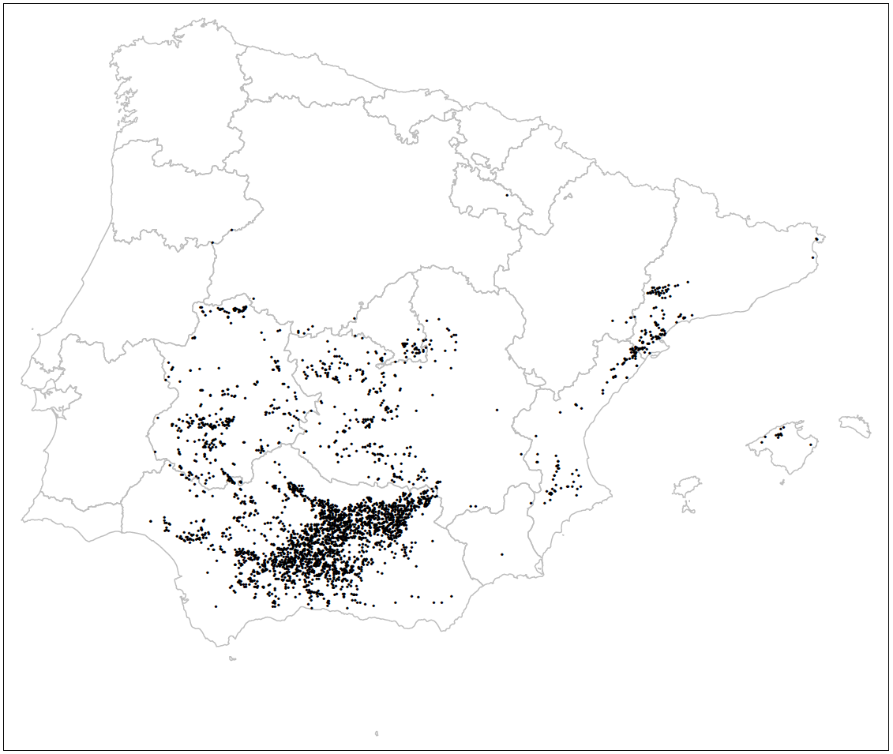
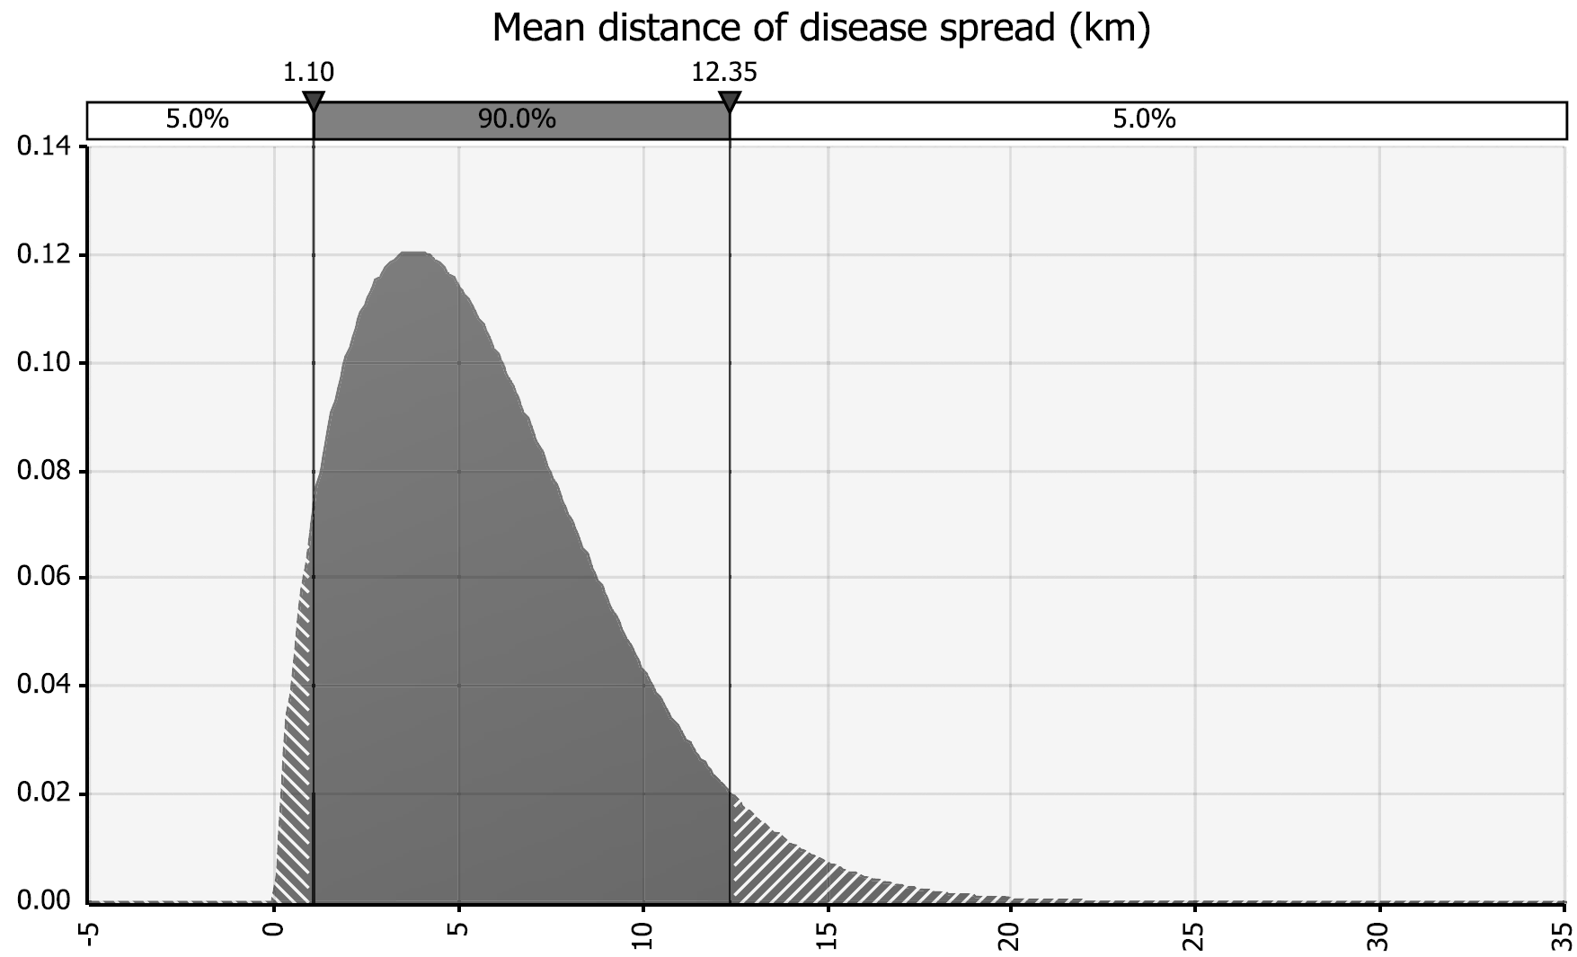
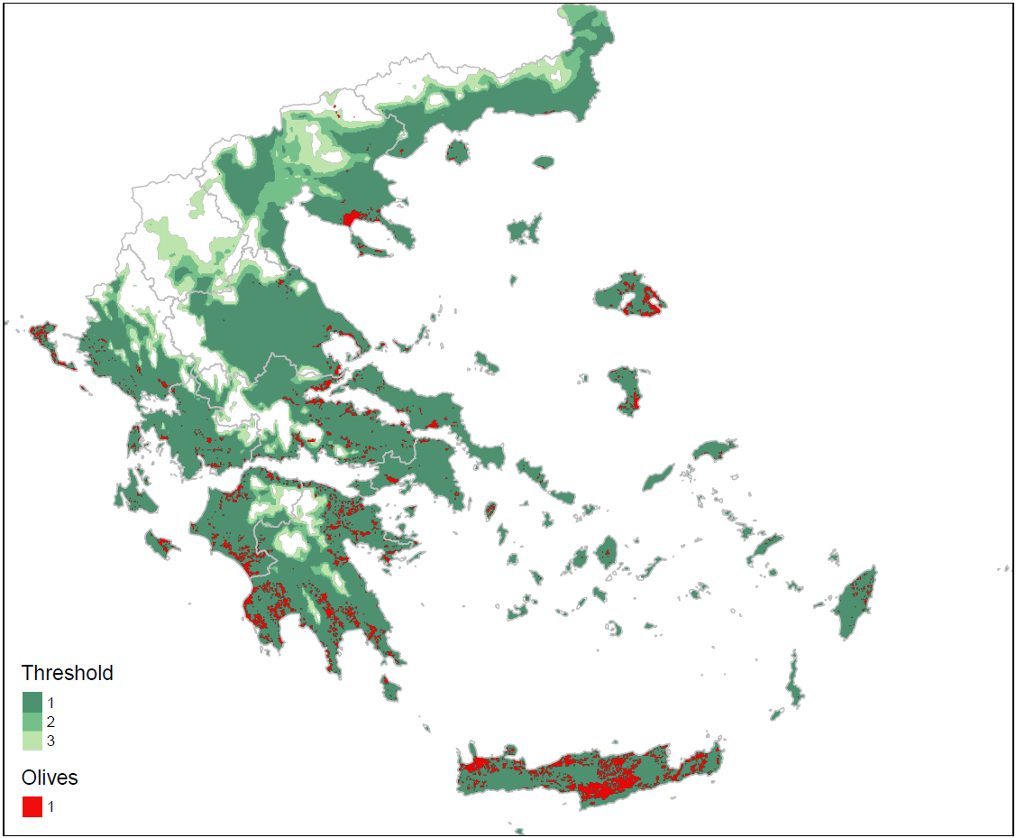
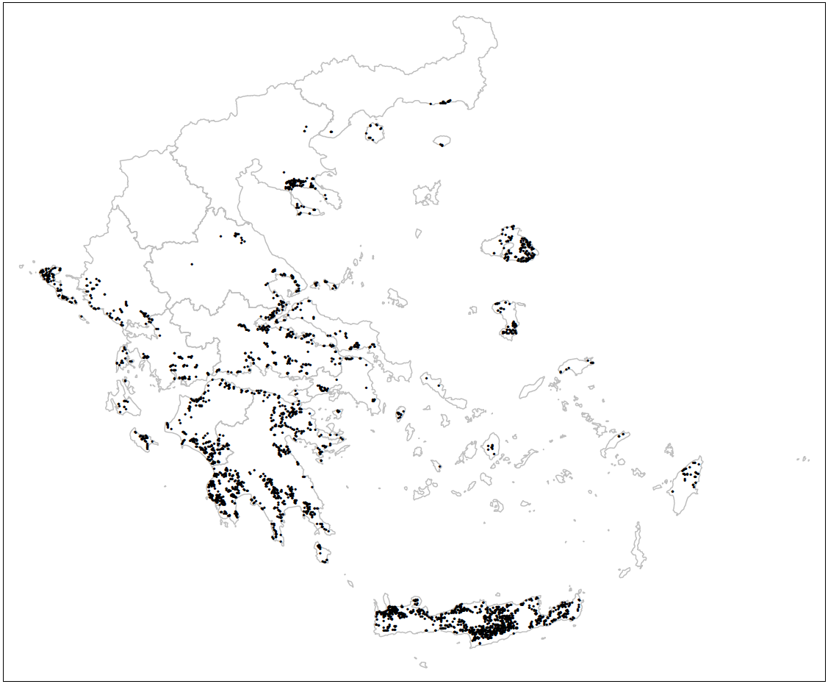
From spread to impact - Uncertainties
1.10, 5.18, 12.35 km per year
Uncertainty on: climatic suitability, points of introduction, and annual spread rate

Slide 5
A Selection of Methodologies for Quantitative Impact Assessments
Objective | Level
Costs (C) | Hectare (H)
Prices (P) | Farm (F)
Trade (T) | Sector (S)
Employment (E) | Region (R)
Social Welfare (W) | National (N)
Mitigation (M) | Global (G)
Methodology | Suitable for | Examples
Cost-Benefit Analysis | C, M, H, F | 1 - 7
Agent-based | C, P, M, H, F | 8 - 12
Linear Programming | C, P, M, H, F | 13 - 16
(Multi-Market) Partial Equilibrium | P, T, W, S, R, N | 7, 8, 17-20
Computable General Equilibrium | P, T, W, E, S, R, N, G | 21-23
Input-Output Table (Social Accounting Matrix) | E, W, S, N | 24, 25
Methodologies are just ways of structuring your problem solving
By tailoring to your needs, you can create necessary overlap

Slide 6
A Cost-Benefit Analysis of Xylella fastidiosa subsp. pauca in olives
(Additional costs + Foregone revenue) – (Reduced costs + Additional revenue)
Simulate yield decline over time (per ha)
Simulate cost increase over time (per ha)
Compute losses in investments (per ha)
Estimate price increase over time (per ton)
Aggregate over cropping systems and countries

Slide 7
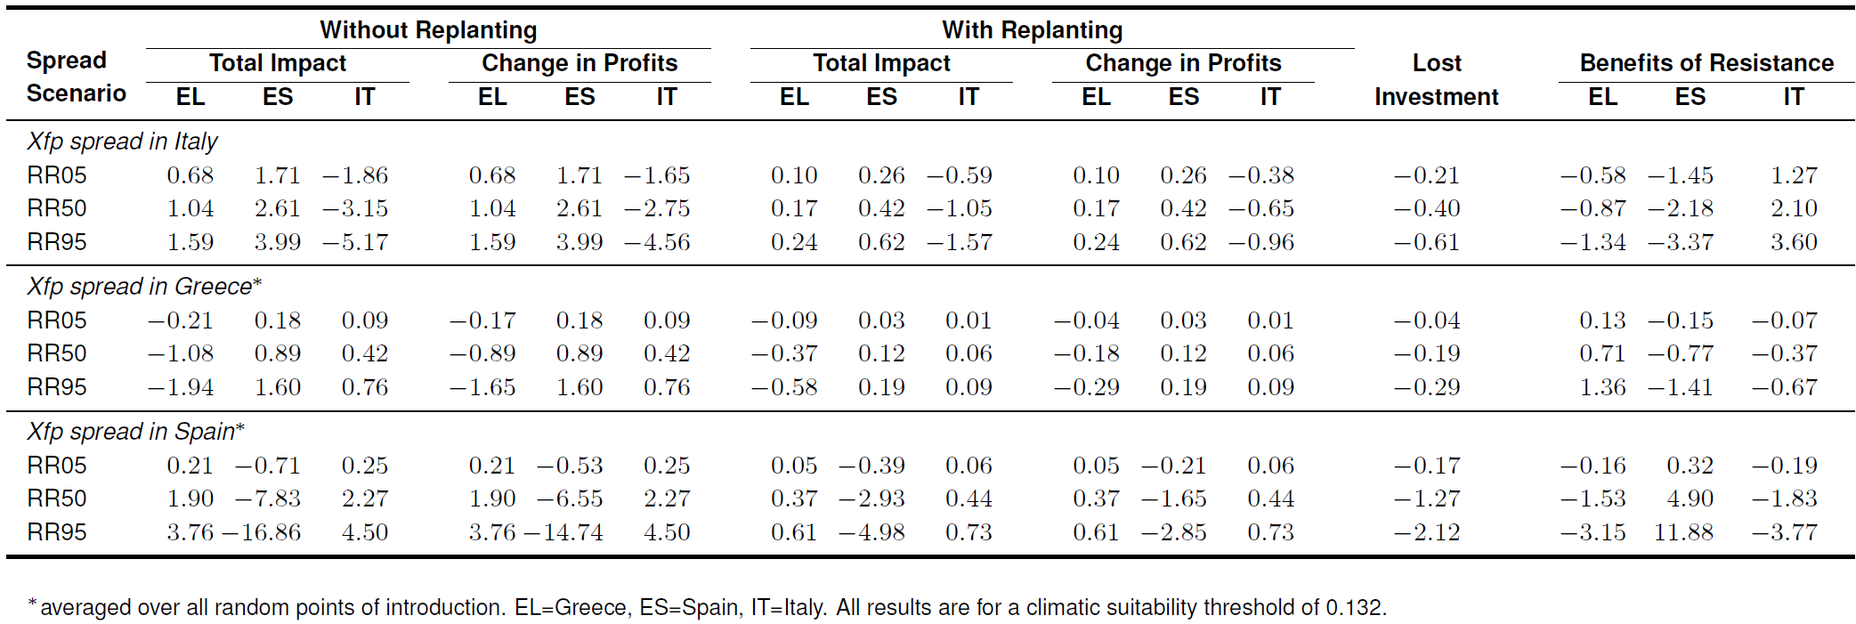
Cost-Benefit Analysis: Economic Impact to Olive Growers over 50 years in billion Euro

Slide 8
Multi-Country Partial Equilibrium Model on Xylella fastidiosa subsp. pauca in olive oil
Supply and Demand form the market equilibrium
The equilibrium determines the price and quantity
Supply and Demand are mathematically expressed
Market data is used to calibrate the initial conditions
The model computes on the aggregate market(s)
Parameters for the yield decline, cost change and the spread simulations are used to estimate the „supply shifter“
Price
New Supply
Supply
p‘
p
Demand
q‘
q
Quantity

Slide 9
Multi-Country Partial Equilibrium Model: Changes in Prices and Consumption of Olive oil over 50 years

Slide 10
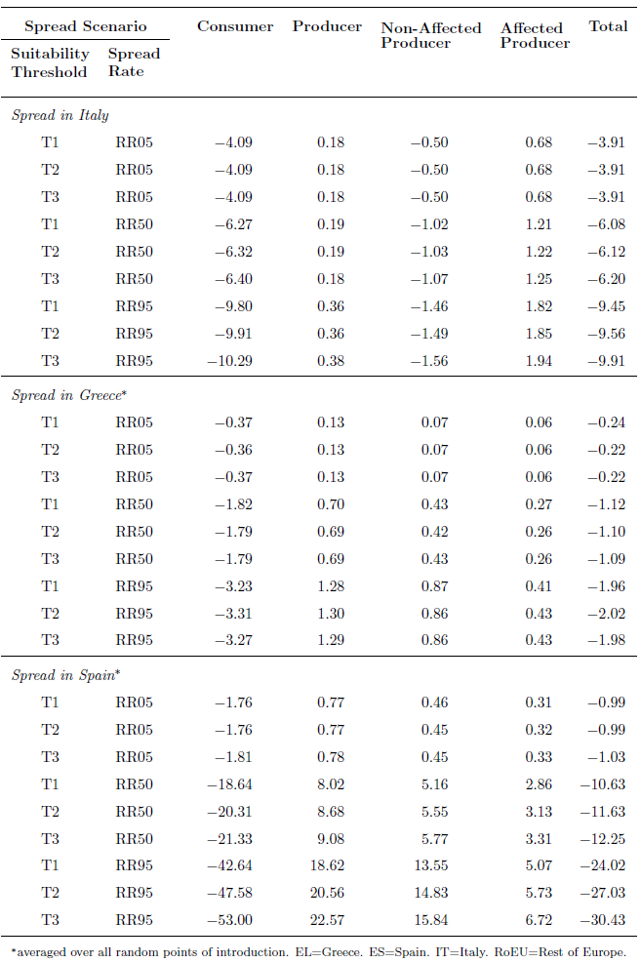
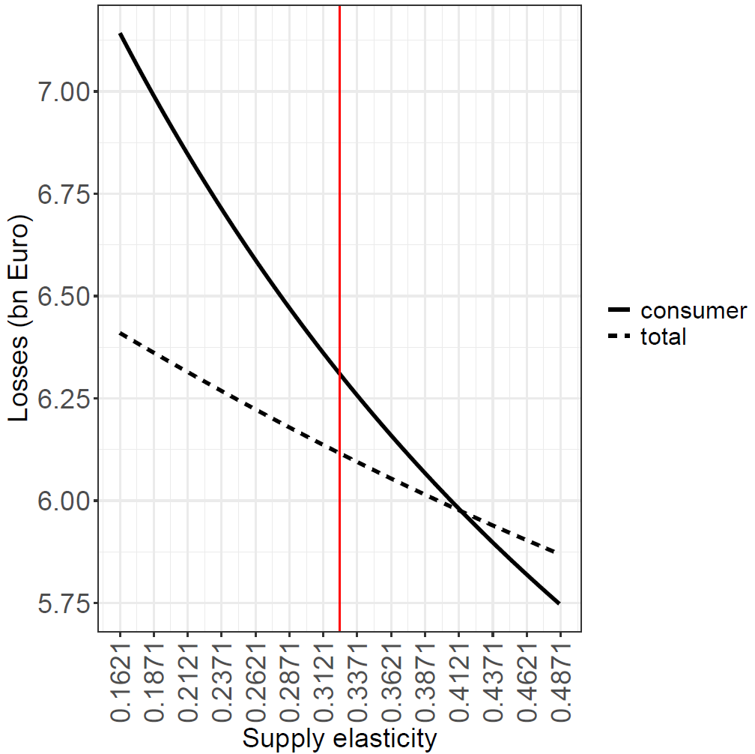
Multi-Country Partial Equilibrium Model: Welfare changes to Olive Oil Processors and Consumers over 50 years in billion Euro
Consumers bear economic impact due to higher prices for olive oil
Markets characterized by producers which are able to respond to prices benefit consumers

Slide 11
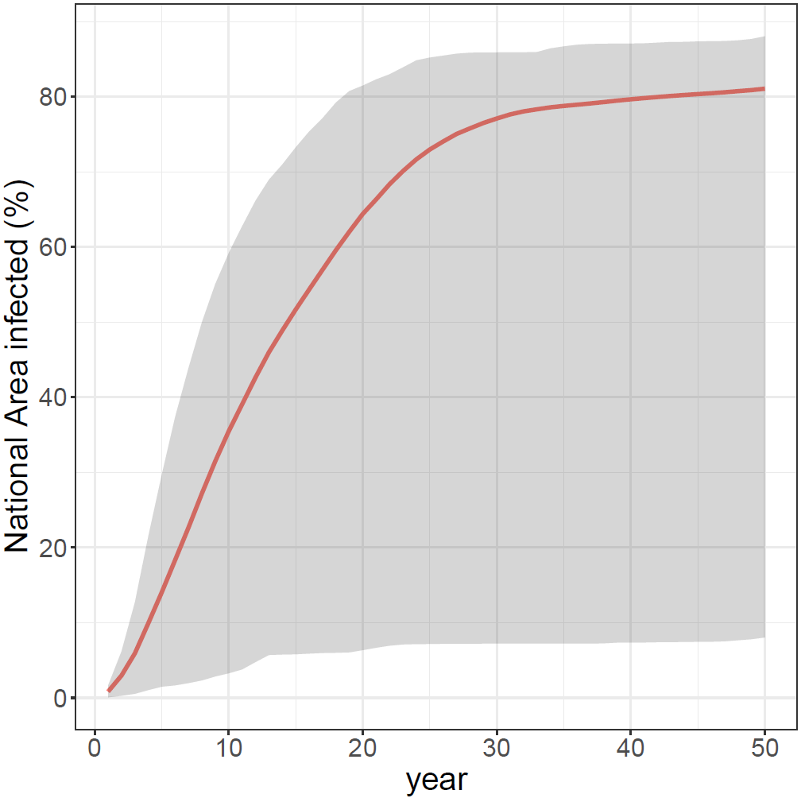
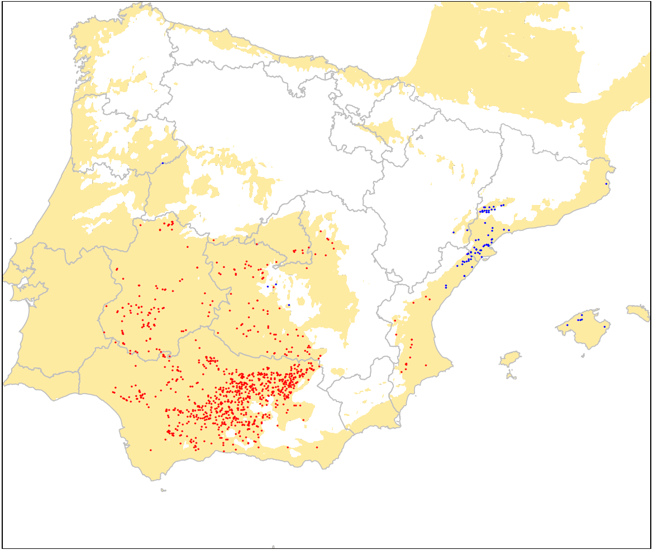
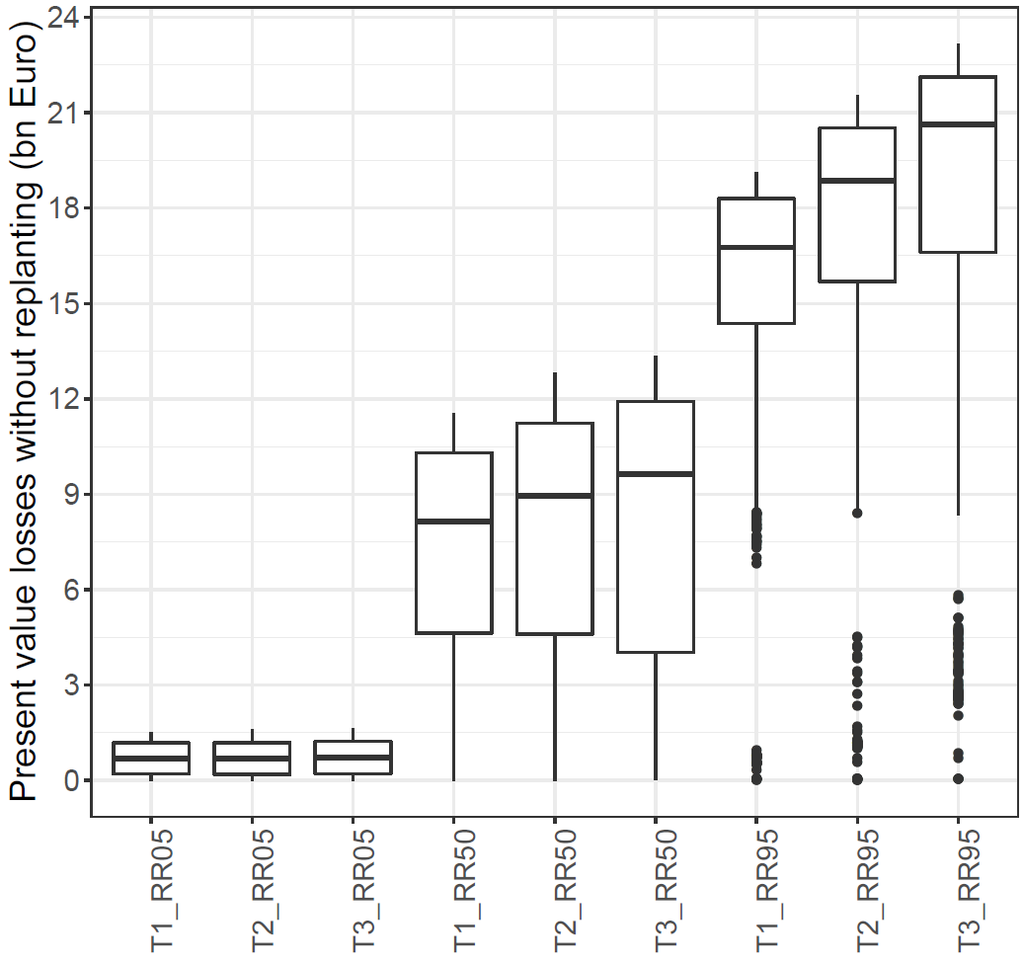
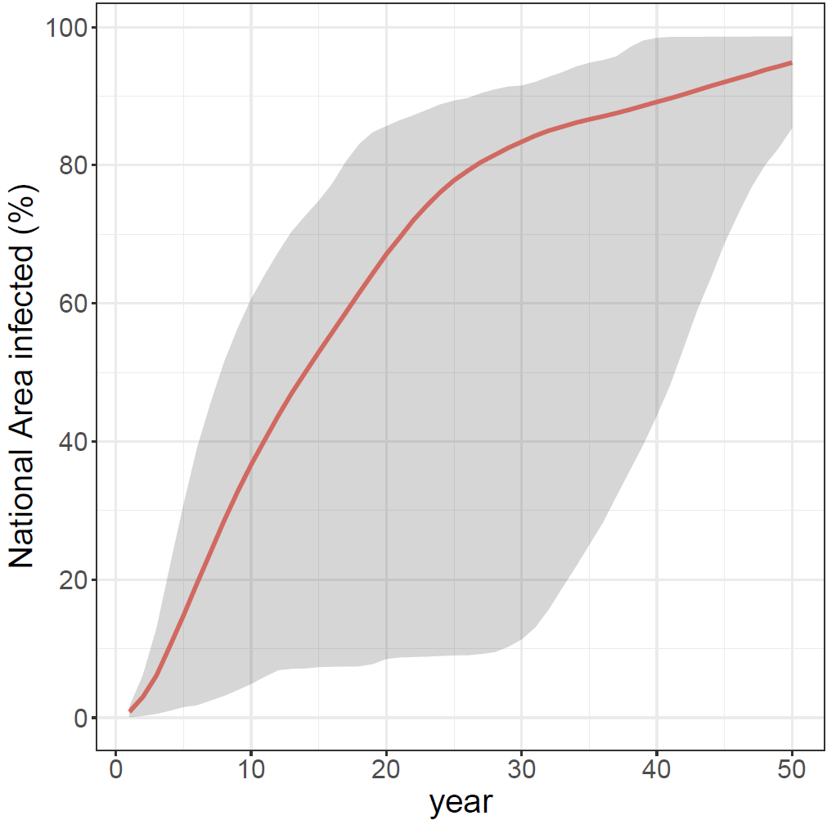
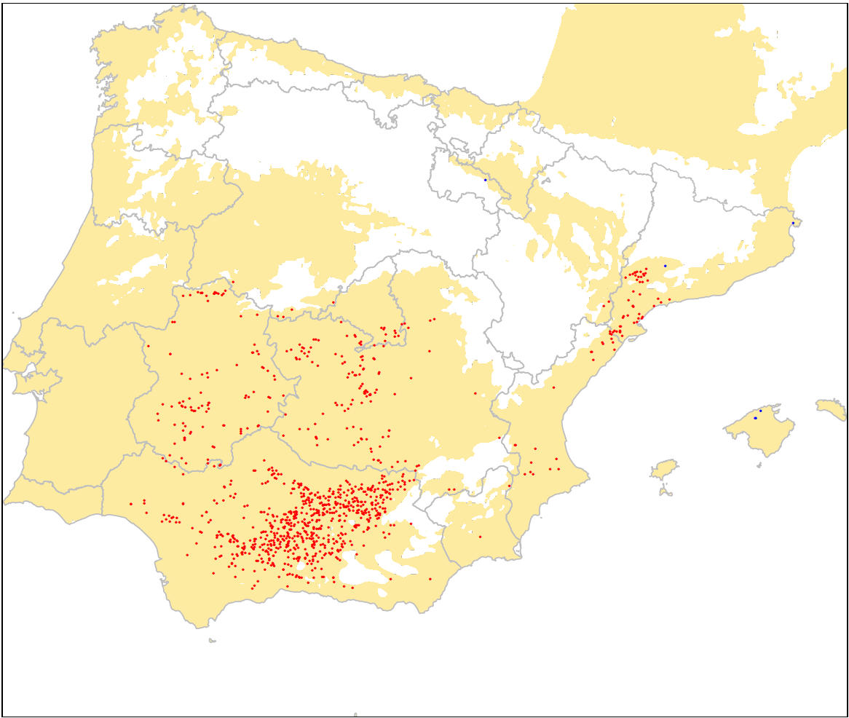
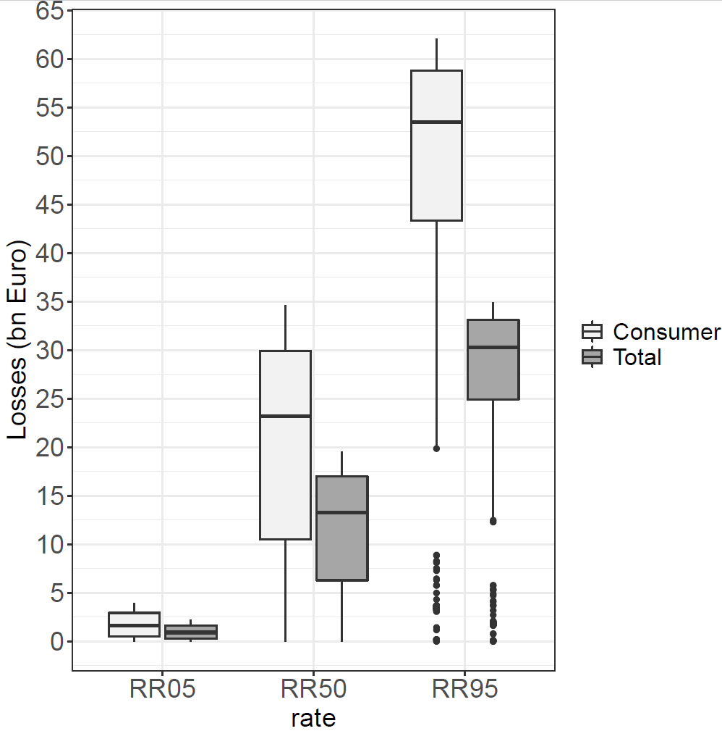
Sensitivity analyses can be informative
T2
T3

Slide 12
Take home messages
There is no such thing as a perfect model that fits all purposes
Trade off detail vs. scope
Employ multiple approaches
Use the modelling work to gain (qualitative) insights on the system
Impacts to affected olive growers, oil processors and consumers are likely to be sizable and they warrant actions from regulators
Sensitivity and uncertainty analyses are not just tests
Expert knowledge is key to success

Slide 14
References
[1] Cook, D. C., & Matheson, A. C. (2008). An estimate of the potential economic impact of pine pitch canker in Australia. Australian Forestry, 71(2), 107-112.
[2] Cook, D. C., Thomas, M. B., Cunningham, S. A., Anderson, D. L., & De Barro, P. J. (2007). Predicting the economic impact of an invasive species on an ecosystem service. Ecological Applications, 17(6), 1832-1840.
[3] Hodda, M., & Cook, D. C. (2009). Economic impact from unrestricted spread of potato cyst nematodes in Australia. Phytopathology, 99(12), 1387-1393.
[4] Knight-Jones, T. J. D., & Rushton, J. (2013). The economic impacts of foot and mouth disease–What are they, how big are they and where do they occur?. Preventive veterinary medicine, 112(3-4), 161-173.
[5] Soliman, T., Mourits, M. C. M., Lansink, A. O., & Van der Werf, W. (2015). Quantitative economic impact assessment of invasive plant pests: What does it require and when is it worth the effort?. Crop Protection, 69, 9-17.
[6] Yemshanov, D., McKenney, D. W., de Groot, P., Haugen, D., Sidders, D., & Joss, B. (2009). A bioeconomic approach to assess the impact of an alien invasive insect on timber supply and harvesting: a case study with Sirex noctilio in eastern Canada. Canadian Journal of Forest Research, 39(1), 154-168.
[7] Soliman, T., Mourits, M. C. M., Lansink, A. O., & van der Werf, W. (2012). Quantitative economic impact assessment of an invasive plant disease under uncertainty–A case study for potato spindle tuber viroid (PSTVd) invasion into the European Union. Crop Protection, 40, 28-35.
[8] Carrasco, L. R., Cook, D., Baker, R., MacLeod, A., Knight, J. D., & Mumford, J. D. (2012). Towards the integration of spread and economic impacts of biological invasions in a landscape of learning and imitating agents. Ecological Economics, 76, 95-103.
[9] Keith, J. M., & Spring, D. (2013). Agent-based Bayesian approach to monitoring the progress of invasive species eradication programs. Proceedings of the National Academy of Sciences, 110(33), 13428-13433.
[10] Rebaudo, F., Crespo-Pérez, V., Silvain, J. F., & Dangles, O. (2011). Agent-based modeling of human-induced spread of invasive species in agricultural landscapes: insights from the potato moth in Ecuador. Journal of Artificial Societies and Social Simulation, 14(3), 7.
[11] Rebaudo, F., & Dangles, O. (2013). An agent-based modeling framework for integrated pest management dissemination programs. Environmental modelling & software, 45, 141-149.
[12] Ameden, H. A., Boxall, P. C., Cash, S. B., & Vickers, D. A. (2009). An agent‐based model of border enforcement for invasive species management. Canadian Journal of Agricultural Economics/Revue canadienne d'agroeconomie, 57(4), 481-496.
[13] Hastings, A., Hall, R. J., & Taylor, C. M. (2006). A simple approach to optimal control of invasive species. Theoretical population biology, 70(4), 431-435.
[14] Kıbış, E. Y., & Büyüktahtakın, İ. E. (2017). Optimizing invasive species management: A mixed-integer linear programming approach. European Journal of Operational Research, 259(1), 308-321.
[15] Bonneau, M., Johnson, F. A., Smith, B. J., Romagosa, C. M., Martin, J., & Mazzotti, F. J. (2017). Optimal control of an invasive species using a reaction‐diffusion model and linear programming. Ecosphere, 8(10), e01979.
[16] Blackwood, J., Hastings, A., & Costello, C. (2010). Cost-effective management of invasive species using linear-quadratic control. Ecological Economics, 69(3), 519-527.
[17] Breukers, A., Mourits, M., Werf, W. V. D., & Lansink, A. O. (2008). Costs and benefits of controlling quarantine diseases: a bio‐economic modeling approach. Agricultural Economics, 38(2), 137-149.
[18] Cook, D. C. (2008). Benefit cost analysis of an import access request. Food Policy, 33(3), 277-285.
[19] Cook, D. C., & Fraser, R. W. (2008). Trade and invasive species risk mitigation: Reconciling WTO compliance with maximising the gains from trade. Food Policy, 33(2), 176-184.
[20] Surkov, I. V., Oude Lansink, A. G., & van der Werf, W. (2009). The optimal amount and allocation of sampling effort for plant health inspection. European Review of Agricultural Economics, 36(3), 295-320.
[21] Wittwer, G., McKirdy, S., & Wilson, R. (2006). Analysing a hypothetical Pierce's disease outbreak in South Australia using a dynamic CGE approach.
[22] McDermott, S. M., Finnoff, D. C., & Shogren, J. F. (2013). The welfare impacts of an invasive species: Endogenous vs. exogenous price models. Ecological economics, 85, 43-49.
[23] Leung, B., Springborn, M. R., Turner, J. A., & Brockerhoff, E. G. (2014). Pathway‐level risk analysis: the net present value of an invasive species policy in the US. Frontiers in Ecology and the Environment, 12(5), 273-279.
[24] Julia, R., Holland, D. W., & Guenthner, J. (2007). Assessing the economic impact of invasive species: the case of yellow starthistle (Centaurea solsitialis L.) in the rangelands of Idaho, USA. Journal of Environmental Management, 85(4), 876-882.
[25] Eiswerth, M. E., Darden, T. D., Johnson, W. S., Agapoff, J., & Harris, T. R. (2005). Input-output modeling, outdoor recreation, and the economic impacts of weeds. Weed Science, 130-137.

Slide 15
Is or isn’t there data?
Data-driven
Regression, Machine learning, Remote Sensing, etc.
Simulation-based
Ex ante analyses
Disease spread, economic models
Ex post analyses

Slide 16
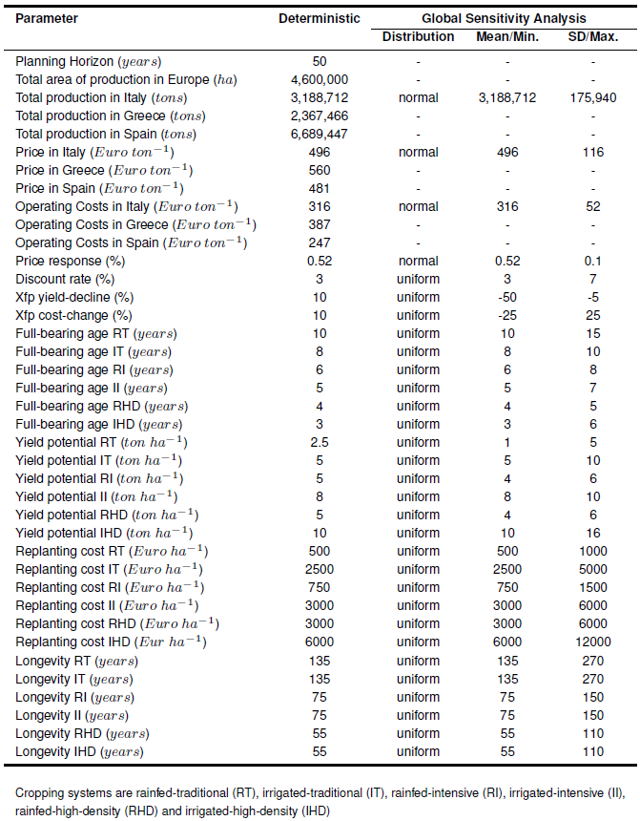
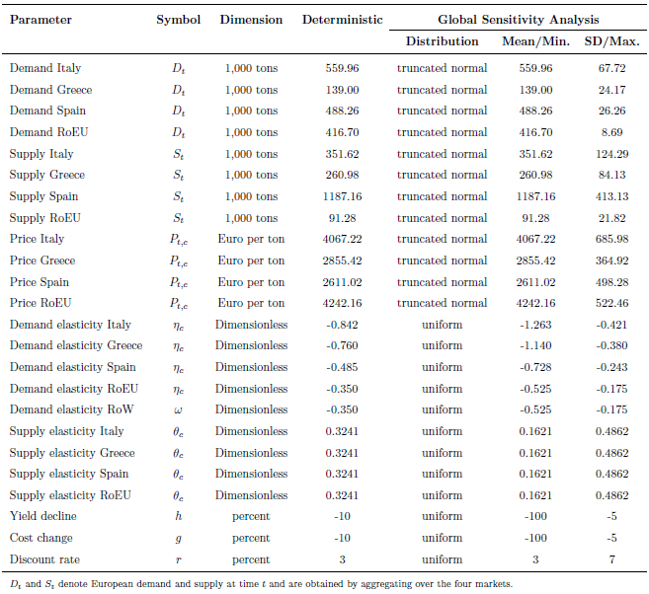
Supplementary Material – Parameter values

Slide 17
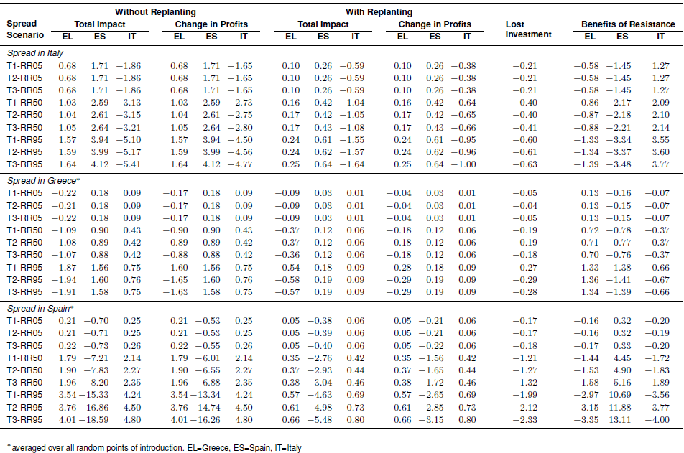
Supplementary Material – Cost-Benefit All Results

Slide 18
Supplementary Material – Partial Equilibrium Model All Results
Spread in Italy
Spread in Greece
Spread in Spain

Slide 19
An example of sensitivity analyses for the economic model
Global sensitivity analysis (Variance decomposition)
Sample N (10,000) draws for each input parameter (k)
Generate „computational experiment“
Compute the model for all (N*(k+2)) combinations
Calculate the Sobol indices (i.e., amount of variance in output caused by variance/uncertainty in an input)

Slide 20
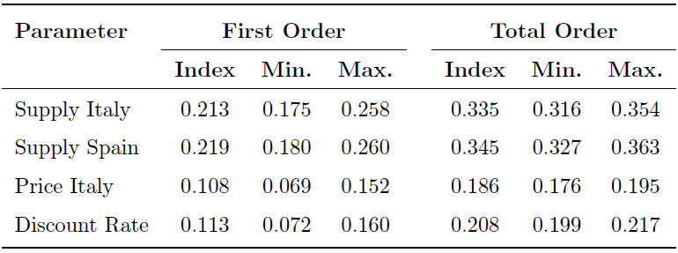
Supplementary Material – Sensitivity of Economic Models
Cost-benefit
Partial Equilibrium

Slide 21
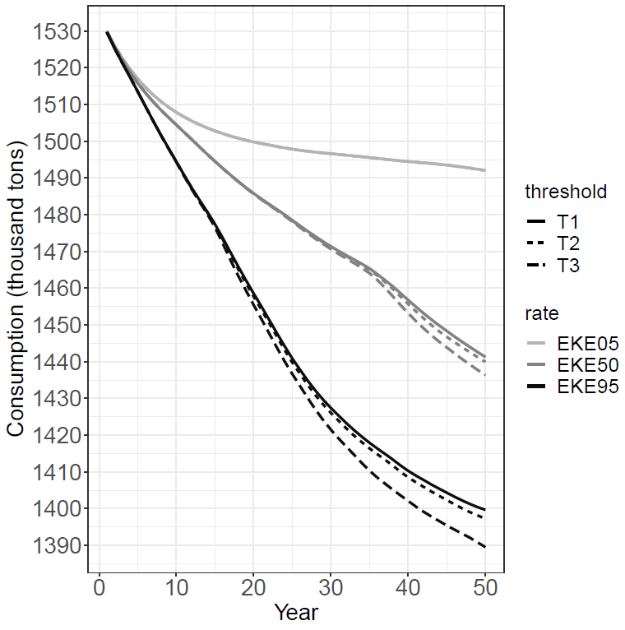
Supplementary Material – Consumption change for Italian spread

Slide 22
Supplementary Material – Olive Oil Market in Equations
$$D_{t} =\sum_{c ∈C}{χ_{c} ⋅P_{tc}^{−η_{c}}}$$
$$S_{t}=SA_{t}+SN_{t}$$
$$SA_{t}=\sum_{c∈C}{\sum_{ax=1}^{T}{{\left(1+h\right)}^{ax}}}⋅ρ_{c}⋅{\left({\left(1+g\right)}^{ax}⋅P_{tc}\right)}^{θ_{c}}⋅z_{ct,ax}$$
$$SN_{t}=\sum_{c∈C}{ρ_{c}}⋅{\left(P_{tc}\right)}^{θ_{c}}⋅\left(1−\sum_{ax=1}^{T}{z_{ct,ax}}\right)$$
$$WP_{t}=P_{tc}−μ_{c}$$
$$E_{t}=S_{t}−D_{t}$$
$$X_{t}=ν⋅{\left(WP_{t}\right)}^{ω}$$
$$X_{t}=E_{t}$$
$$iPS_{t}=\sum_{c∈C\backslash }{\left(\left(\int_{a}^{P_{tc}}{S_{t}^{0}\left(P_{tc}\right)δP_{tc}}−\int_{b}^{P_{t+1,c}}{S_{t}^{1}\left(P_{tc},N_{ct}\right)δP_{tc}}\right)⋅{\left(1+r\right)}^{−t}\right)}$$
$$iCS_{t}=\sum_{c∈C}{\left(\left(\int_{P_{tc}}^{P_{t+1,c}}{D_{t}\left(P_{tc}\right)δP_{tc}}\right)⋅{\left(1+r\right)}^{−t}\right)}$$
$$iTW=\sum_{t=1}^{T}{\left(iPS_{t}+iCS_{t}\right)}$$

